Slide 1
Longitudinal Finned Double pipe HE
Week -3
By
Dr.Swambabu Varanasi
Dr. Koustav Ray

Slide 2
Double pipe heat exchanges

Slide 3


Wall Temperature

Slide 4
Finned DPHE
When one fluid has poor heat transfer coefficient compared to other other fluid – Finned DPHE is used
Fins provides additional surface area to compensate poor hear transfer rate.
Criteria :
Caution: if composite resistance (1/h) is less than 0.002 m². K/W – usefulness of fins diminishes significantly
(efficiency of the fin is lower the 50%)

Slide 5
Configuration of fins

Slide 6
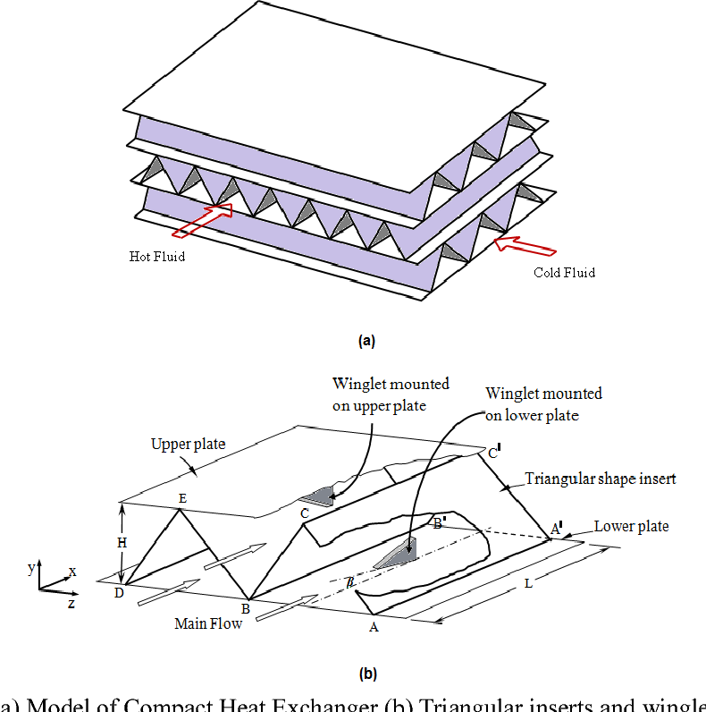

Slide 8
Flow area and D_{e} calculations
Cross sectional area
n_{f} = no of fins
Heat Transfer
Wetted perimeter = outside bare surface
exclusive of surface
under fins
+
surface of both sides of fins
and tip of the fins
)]
If tip of the surface presumes to be adiabatic

Slide 9
Here I introduced n_{T}, which no of tube for multiple tubes inside the shell
For a single tube, n_{T} = 1
For pressure losses
n_{T}
+
)]

Slide 10
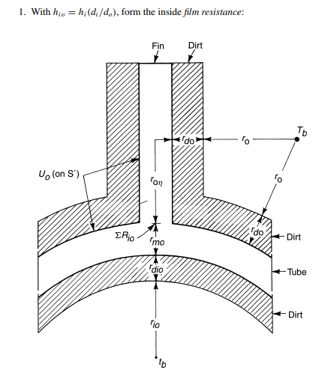
Overall heat transfer coefficient estimation
Estimate h_{i}

Slide 11
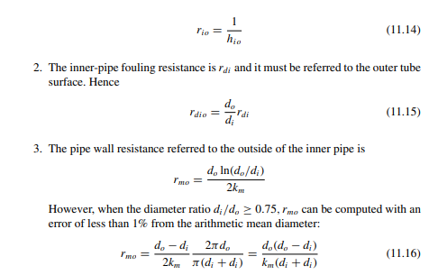

Slide 12
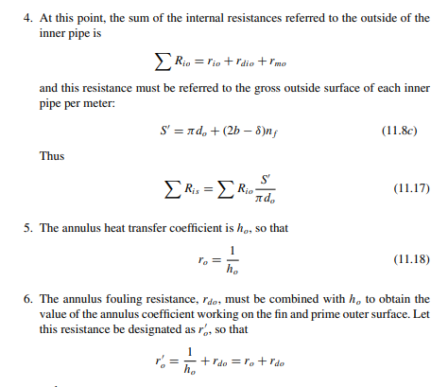

Slide 13
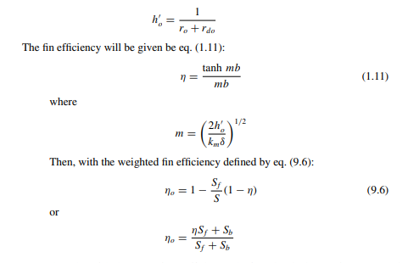

Slide 14
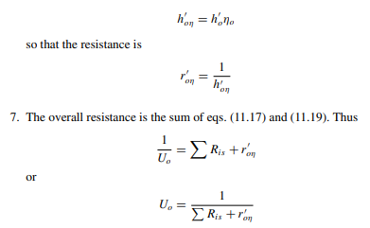

Slide 15
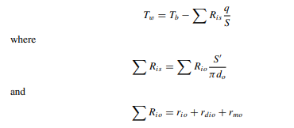

Wall Temperature for finned surface
If hot fluid inside the tube
If cold fluid inside the tube

Slide 16
Assignment - 2
In a marine application, x kg/s of engine oil is to be cooled from 117°C to 77°C using seawater entering at 17°C and leaving at 37°C. Fouling resistances of 0.00018 m²·K/W for the engine oil and 0.0001 m²·K/W for the water are to be used. The allowable pressure drops are 65 kPa (≈10 psig) and 80 kPa (≈ 15 psig) for the water and oil, respectively.
Determine the arrangement of longitudinal fin double-pipe exchangers for this service if both the inner pipe and the annulus are connected in series and if the length of each hairpin is 3 m. The thermal conductivity of the exchanger material is 52 W/m·K.
x= flowrate = group no/3

Slide 17
